Slide 1
Protocol Deviations

Slide 2

Protocol Deviations
Deviations from the protocol are expected, and may be site or participant-driven
  No one is perfect!
However, we need to learn from our mistakes and major deviations will be looked at critically
  It is critical that the team is aware of what would be considered a major deviation and how to prevent these from occurring

Slide 3
Identification of deviations
Protocol deviations may be identified through any of the following mechanisms:
Site internal QA/QC procedures
PPD assessment visits
SCHARP notification through data review
Study management team assessment visits

Slide 4
Reporting of deviations
Report deviation by completing the Protocol Deviation Log CRF
Submit PD Log CRF within 7 days of site awareness
Recommend routine reporting to IRBs/EC (e.g. with annual review) according to local policies
Recommend expedited reporting of PDs that pose a potential safety risk to participant(s) or those that could affect the integrity of the study
Notes:
These listings can be provided by MTN to the sites on request. Sites should request these PD listings from SCHARP at least two weeks prior to the planned date of submission to their local IRBs/ECs.

Slide 5
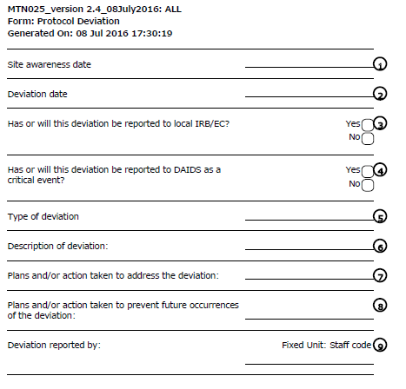
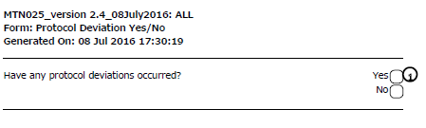
Protocol Deviation Log
Notes:
There is a trigger question for this form. If there are any protocol deviations to occur, selecting yes will open up the form.

Slide 6
PD Log CRF Completion
Site Awareness Date – date site became aware this was a PD requiring reporting
Deviation date – date deviation occurrerd or start date if deviation lasted >1 day

Slide 7
PD Log CRF - continued
Has or will this PD be reported to local IRB/EC?
  Select “yes” if planning to send or already sent deviation to the IRB/EC.
  May not use “no” often – just included if PD should have been reported but was not
Has or will the PD be reported as to DAIDS as a critical event? ‘Yes’ or ‘no’

Slide 8
Critical Events
Some PDs may also be considered critical events
Not all critical events are considered PDs
Refer to the DAIDS Critical Event Policy and Critical Event Manual for detailed guidance on the definition of critical events and reporting processes.
The site OCSO Program Officer should be contacted with questions related to critical events, (e.g. reporting requirements/procedures, CAPA plans, critical events tracking questions.)

Slide 9
PD Log CRF - continued
Type of deviation
  Select applicable deviation from the dropdown menu/enter on the paper CRF
  If you are unsure of which deviation to record, consult MTN Regulatory/MTN-025 management team

Slide 10
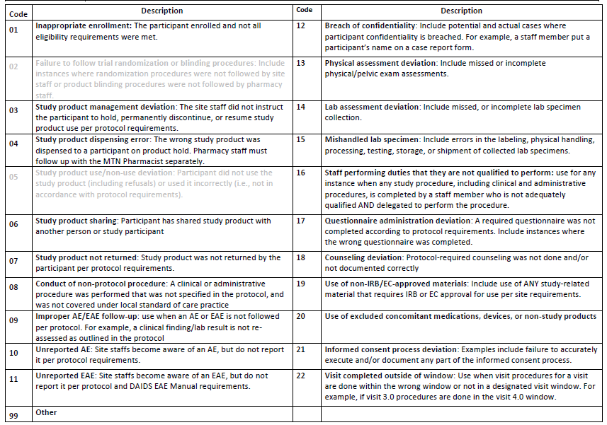
Notes:
Note that deviations not applicable to HOPE will not be available. This is now a drop down menu in Medidata Rave and no number codes will be entered.

Slide 11
PD Log CRF - continued
Brief description of the actual deviation
Describe your corrective action for the deviation
Describe your preventative action plans (do not need to be final or completed at time of report)
  Needs to be specific and applicable to the deviation
  “will not do it again” – not good
  Discuss re-training plans, plans for system modifications, etc.

Slide 12
PD Log CRF - continued
Record Staff Code number assigned to staff member reporting the deviation
  Create staff codes if not already in place

Slide 13
What is reported on PD Log CRF
If you are unsure if the event should be reported as a deviation, contact the MTN Regulatory/MTN-025 Management
Remember – 1 deviation per PTID per CRF
  For off-site visits where multiple procedures are not done (as planned), use “other” category to explain/document missed procedures

Slide 14
Do Not Report on a PD CRF
The below should not be reported as PDs on a PD Log CRF:
Missed Visits
  These are captured via the Missed Visit CRF; do not need to also report on PD Log CRF
Instances where a CRF is not completed correctly
Instances where an item on an interviewer-administered CRF is skipped in error
Cases where CRFs are not completed or submitted in a timely manner

Slide 15
After a PD is reported…
‘Next steps’ or other follow up related to implementation (or prevention of further deviations) will come from the study management team

Slide 16

Questions?

